Slide 1
Topic 17:
Remote Sensing
17.1 Production and use of X-rays
17.2 Production and uses of ultrasound
17.3 Use of magnetic resonance as an imaging technique

Slide 2
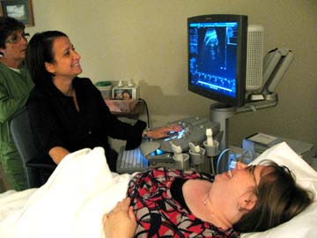
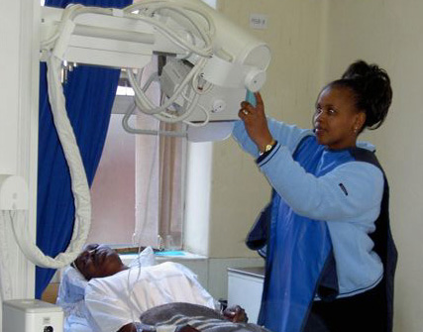

Remote Sensing in Medicine
Non-invasive technique
No surgery
No trauma
No infection
X-ray
MRI
Ultra-sound
CT

Slide 3

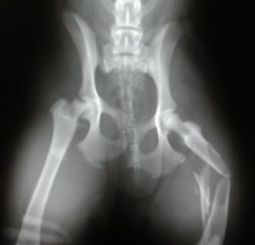
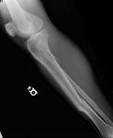

X-Ray
X-ray has long been used to take pictures of broken bones

Slide 4
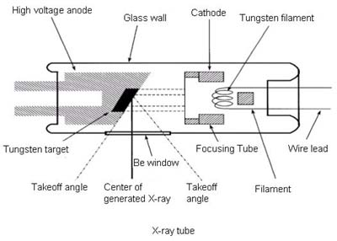
Production of X-Ray
Electrons emitted at the cathode is accelerated through the vacuum tube to hit the metal block anode.
On hitting the target 90% of the energy is converted to heat, 10% or less to X-ray
Thermionic Emission: The cathode is heated by electrical means and electrons are emitted
The anode has to be cooled by various methods.
To produce X-ray, p.d. between anode and cathode must be 20 kV– 100 kV

Slide 5
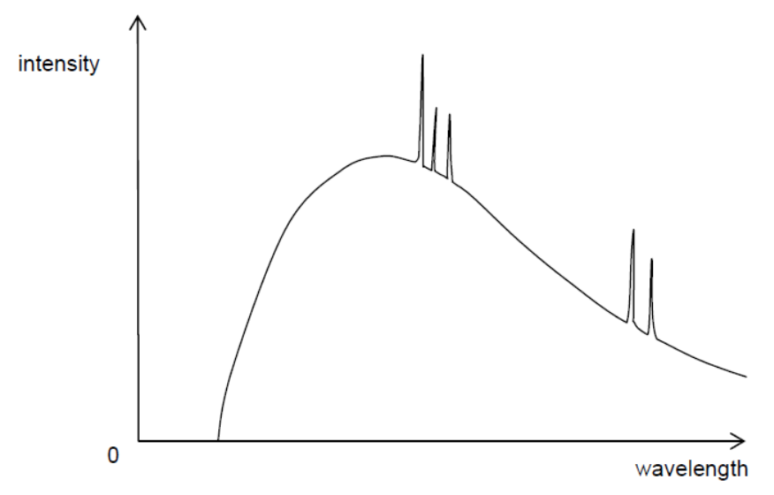
Production of X-Ray
X-rays are produced by two main mechanisms and come in two varieties.
Bremsstrahlung X-rays
Characteristic X-rays
The resultant spectrum has two components

Slide 6
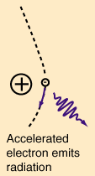
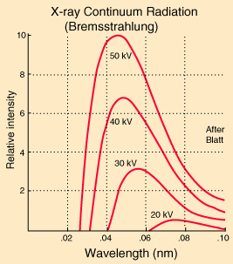
Bremssthrahlung X-rays
Bremsstrahlung is a German word meaning “braking radiation” which describes the process of X-ray generation.
The high speed electron impacts on the target and at the atomic level approaches the nucleus.
There is no actual collision between electron and nucleus because the electron interacts with the Coulombic nuclear forces and its vector quantities of direction and velocity are changed.
The change in energy is radiated as electromagnetic radiation. The large amount of energy means a short wavelength within the X-ray band.
As the electron is not destroyed, it can undergo multiple interactions, and even initial interactions will vary from minor to major energy changes depending on the actual angle and proximity of attack, and the point of 'impact' on the nucleus.
As a result, bremsstrahlung radiation will have continuous spectrum where the maximum energy relates to the entire KE of the electron.
maximum kinetic energy of an electron = eV = hc / λ

Slide 7
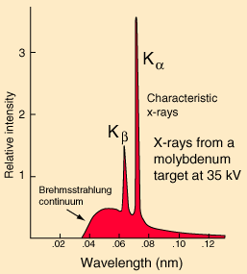
Characteristic X-rays
Some of the bombarding electrons will collide with the orbitting electrons. Sufficient energy in such collisions can result in the ejection of an orbiting electron. 'Sufficient energy' means enough to overcome the bonding energy of the orbiting electron.
The impacting electron will move off with reduced energy, and the ejected electron will move off in a different direction and speed with the remaining energy,
There is an empty position in one of the shells. The remaining orbiting electrons will 'pack down' to fill the hole, and when changing orbits will lose energy and emit this as radiation.
The orbiting levels are fixed as a physical property fixing the elemental identity of an atom, and so the energy emission will be characteristic of that atom.
The energy will be mono-energetic and so appear as a spike rather than a continuous spectrum. Electrons ejected come from the n = 1, 2 and 3 orbits. The atom becomes an ion as it has lost an ejected electron.
All atoms will produce characteristic radiation but not all are visible in the X-ray portion of the electromagnetic spectrum. Tungsten and Mobydenum have theirs in the X-ray region.

Slide 8
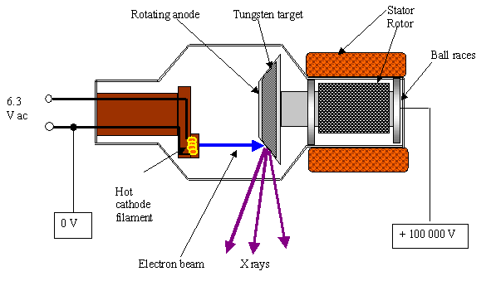
Cooling of the Anode
The anode is either water-cooled or is made to spin rapidly so that the target area is increased

Slide 9
Intensity of the X-ray beam
The intensity of the X-ray beam is determined by the rate of arrival of electrons at the metal target, that is, the tube current.
This tube current is controlled by the heater current of the cathode.
The greater the heater current, the hotter the filament and hence the greater the rate of emission of thermo-electrons.

Slide 10
Hardness of the X-ray beam
The hardness of an X-ray beam refers to its penetration power.
The hardness is controlled by the accelerating voltage between the cathode and the anode.
More penetrating X-rays have higher photon energies and thus a larger accelerating potential is required.
Referring to the spectrum of X-rays produced, it can be seen that longer wavelength X-rays (‘softer’ X-rays) are also produced.
These X-ray photons are of such low energy that they would not be able to pass through the patient.
They would contribute to the total radiation dose without any useful purpose.
Consequently, an aluminium filter is frequently fitted across the window of the X-ray tube to absorb the ‘soft’ X-ray photons.

Slide 11
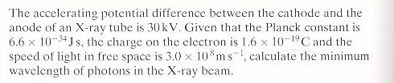
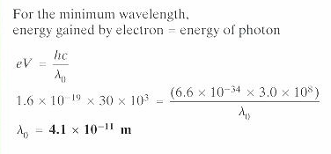
Example
Solution:

Slide 12
X-ray Imaging
X-ray radiation affects photographic plates
X-ray beams are used to obtain ‘shadow’ pictures of the inside of the body to assist in the diagnosis or treatment of illness.
If a picture is required of bones, this is relatively simple since the absorption by bone of X-ray photons is considerably greater than the absorption by surrounding muscles and tissues.
X-ray pictures of other parts of the body may be obtained if there is sufficient difference between the absorption properties of the organ under review and the surrounding tissues.

Slide 13
Quality of the Image
The quality of the shadow picture (the image) produced on the photographic plate depends on its sharpness and contrast.
Sharpness is concerned with the ease with which the edges of structures can be determined. A sharp image implies that the edges of organs are clearly defined.
An image has good contrast if there is a marked difference in the degree of blackening of the image between one organ and another.

Slide 14
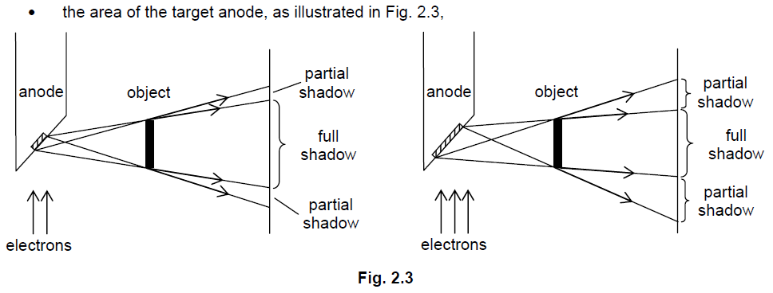
To Obtain Sharp Images
The X-ray tube is designed to generate a beam of X-rays with minimum width. Factors in the design of the X-ray apparatus that may affect sharpness include:

Slide 15
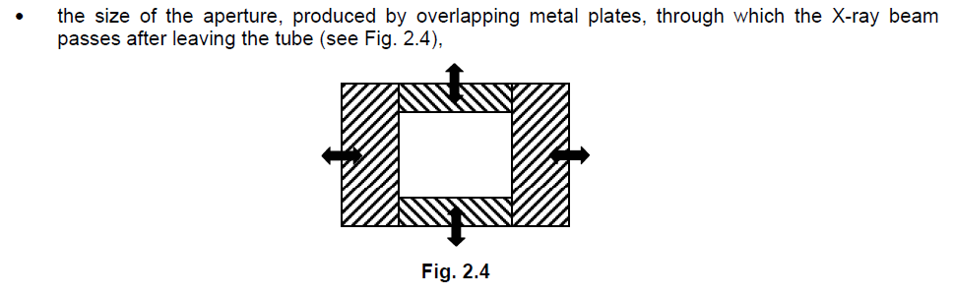
To Obtain Sharp Image

Slide 16
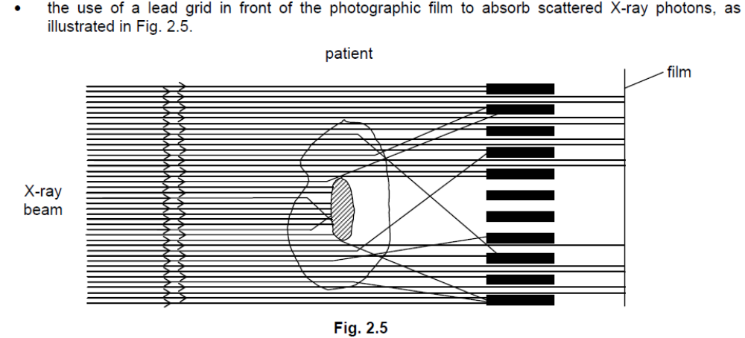
To Obtain Sharp Image

Slide 17
To Obtain Good Contrast
Use a ‘contrast medium’. For example, the stomach may be examined by giving the patient a drink containing barium sulphate. Similarly, to outline blood vessels, a contrast medium that absorbs strongly the X-radiation would be injected into the bloodstream.
The contrast of the image produced on the photographic film is affected by
  exposure time,
  X-ray penetration and
  scattering of the X-ray beam within the patient’s body.
Contrast may be improved by backing the photographic film with a fluorescent material.

Slide 18
Attenuation of X-ray
Attenuation refers to the reduction of intensity.
The intensity of the X-rays is reduced as it travels through a medium.
I = I₀e^{–μx}
μ is the linear absorption coefficient or linear attenuation coefficient of the medium.
The unit of μ is mm^{–1} or cm^{–1} or m^{–1}.
x is the thickness of the medium passed through

Slide 19
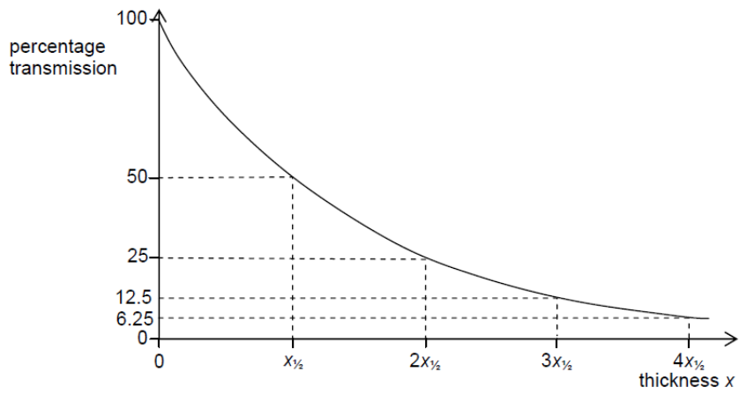
Half-value Thickness (HVT)
The half-value thickness x_{½} or HVT is the thickness of the medium required to reduce the transmitted intensity to one half of its initial value.
It is a constant and is related to the linear absorption coefficient μ by the expression
x_{½} × μ = ln2.
In practice, x_{½} does not have a precise value as it is constant only when the beam has photons of one energy only.

Slide 20
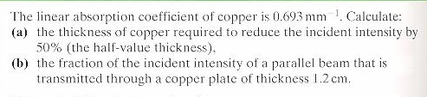
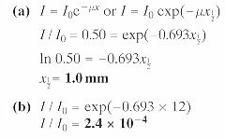
Example
Solution:

Slide 21
Homework
Compare the imaging process of X-ray with that of MRI, CT and ultrasound.
List its advantages and disadvantages compared to each of them.

